Slide 1
Web view
Prepared By: Amir Shrestha
LC00017000502
(BIT 6th Semester)

Slide 2
Introduction:
Q. So what is Web View?
A Web View is a browser rendering engine embedded within native application, which is used to display web content within an application.

Slide 3

Hmm....🤔🤔🤔 Seems confusing?
Ok, then let's get deeper. 💡💡💡

Slide 4
Web View in real time.
App in your device may have a link to external website, which on click loads a particular webpage.
Here external webpage page gets loaded in browser outside the current running app, which is bad user experience as we are out of our application.

Slide 5
Therefore, ladies and gentlemen, here I present you WebView.
That loads the external webpage on the top of or inside current running app, without redirecting outside current running application.
See example on next slide:

Slide 6
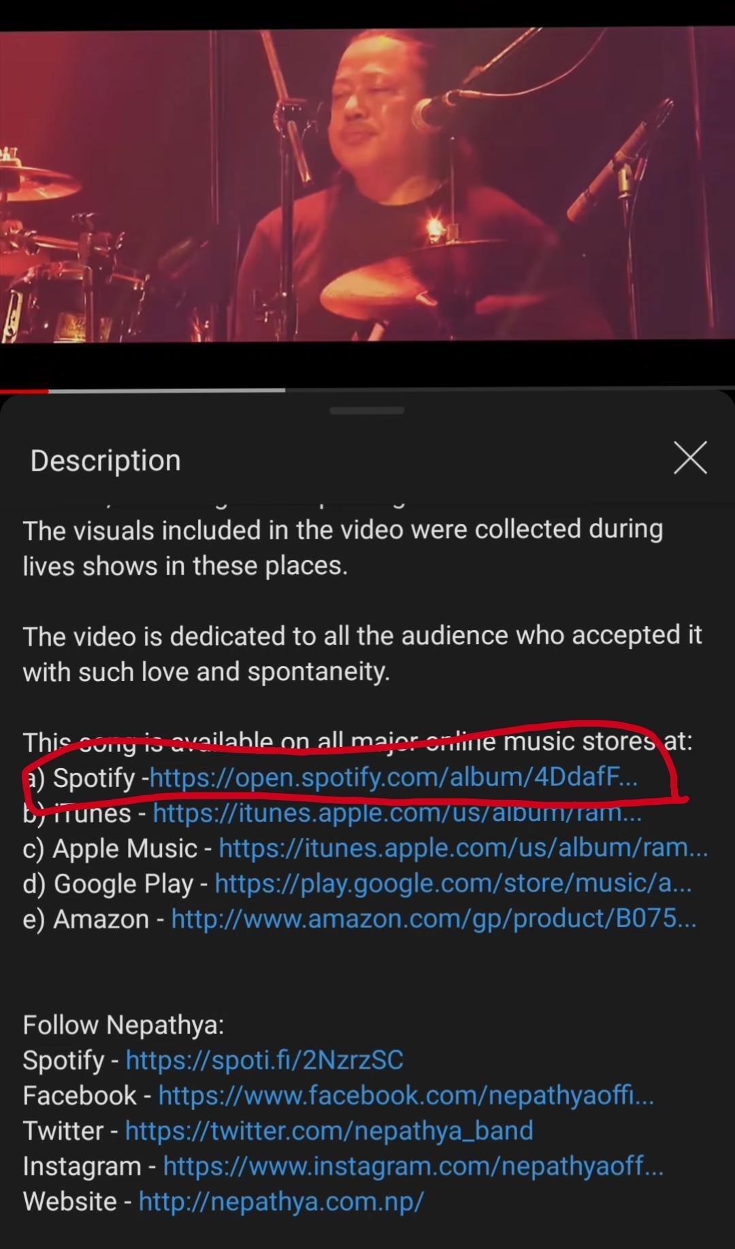
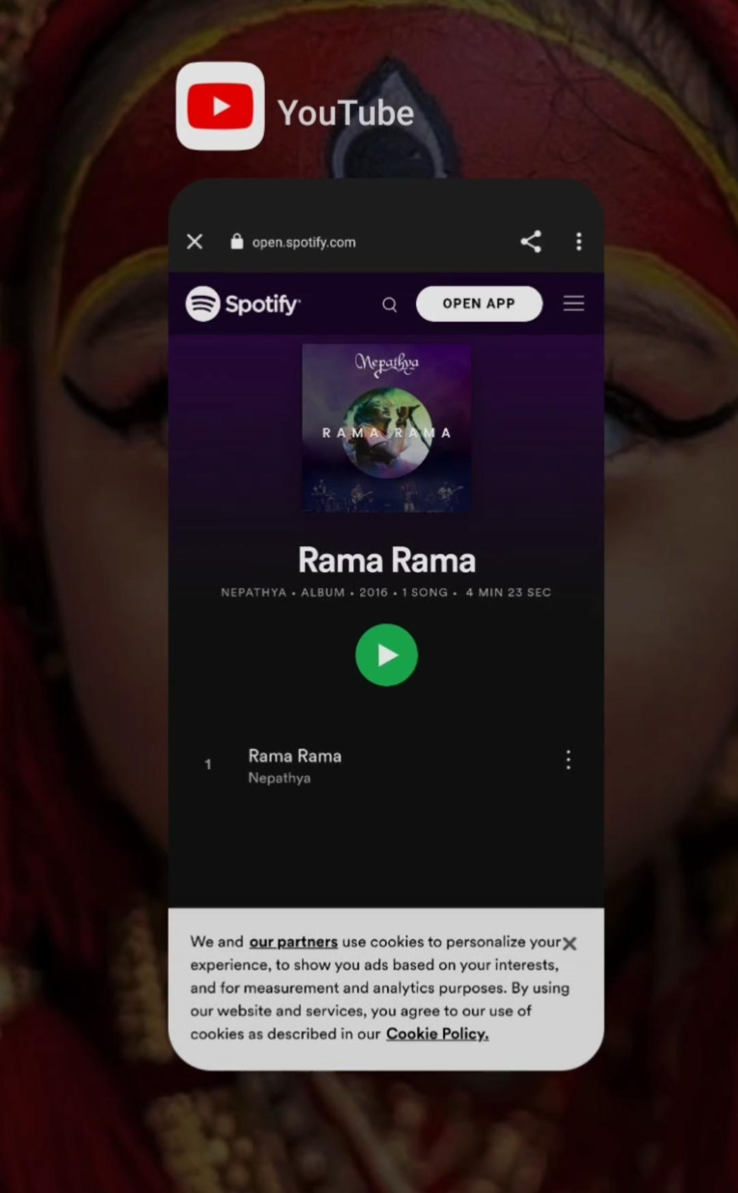
Example:
Here you can see there is Spotify link in Youtube vedio description. So when ever user click to that link spotify is loaded on top of youtube.

Slide 7
Web View:
In case, if there was no WebView in our system then we get redirect to another website(in pervious example Spotify) outside(browser) our current app.
Therefore, main purpose of this system app is to maintain user experience, as we click any link we don't get redirect to some other app.

Slide 8
WebView as a rendering engine:
Till now we talk WebView as a rendering engine of a device.
As we know that different device have their own operating system. So various OS has their respective web rendering engine.
WebKIT in iOS: browser on iOS actually uses WebKIT.
Blink in Andriod: browser on iOS actually uses Blink.
Likewise, Window, Linux, macOS have their lots of WebView choices.

Slide 9


